Slide 1




What’s New?
A Deep Dive into What News Articles are Talking About
IST 736 Final Project - Spring 2023
LIVE
Adrianne Van
Nick Videtti
Andrew Taylor
Brian Vennemann

Slide 2

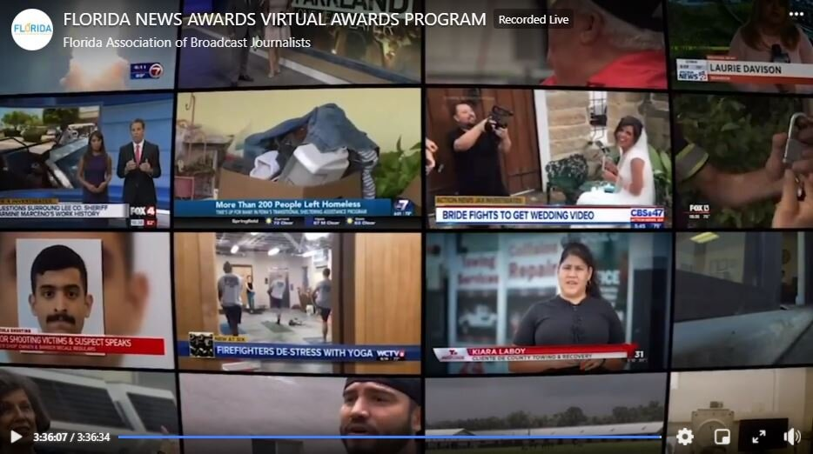
What’s New?
The news keeps us informed of changing current events, issues and people locally and globally.
People watch news for education and for entertainment.
The news is reported through different media from printed paper via newspaper and magazines to broadcasting over radio and television to the internet.

Slide 3
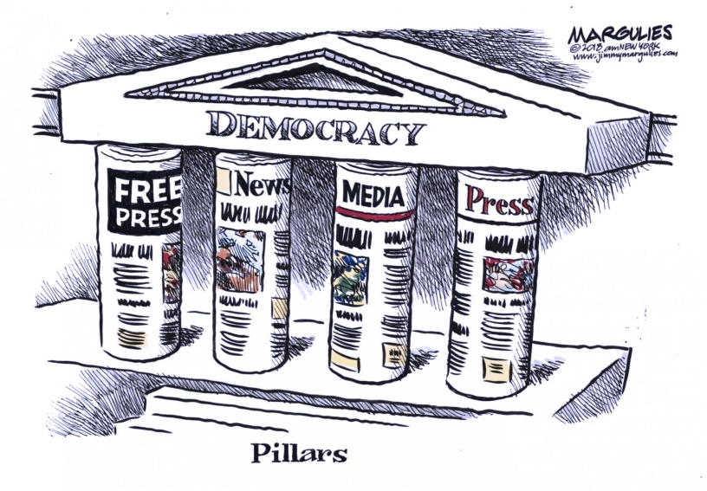
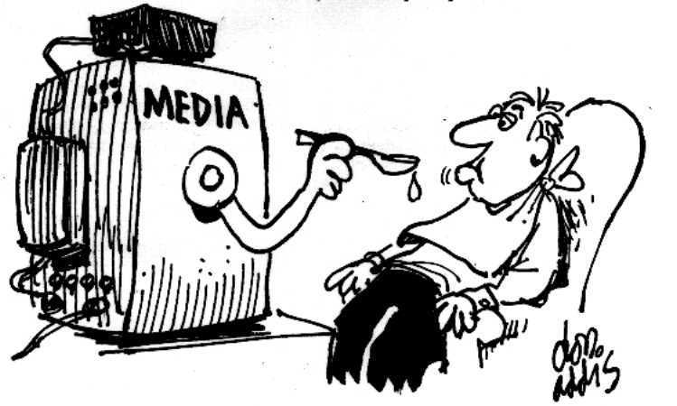
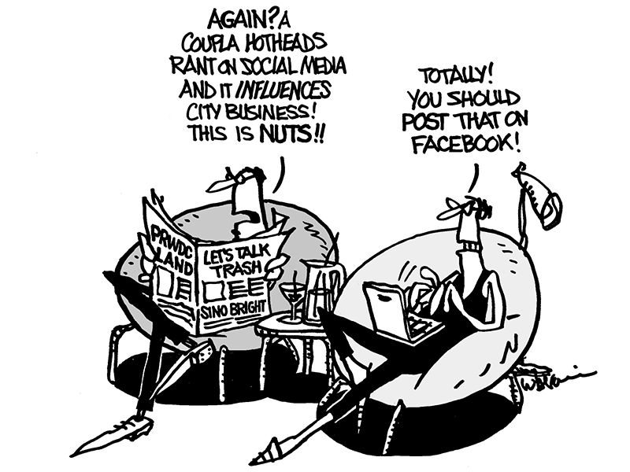
Why Does The News Matter?
Influences our view of the world, perspective of and response to current events, issues and people.
Can become a source of knowledge, whether factual or not, and basis for shaping opinions.
Everyone is aware of the news, whether they seek it out directly or indirectly hear or read about it.

Slide 4





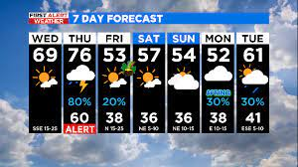
Project Objectives and Goals
Using NewsAPI...
Sports
Health
Politics
Climate
Weather
Predict News Topic
Predict Sentiment
Topic Modeling with LDA

Slide 5
About NewsAPI Source: NewsAPI Documentation (https://newsapi.org/docs)
"News API is a simple HTTP REST API for searching and retrieving live articles from all over the web."
Search Parameters:
Keyword or Phrase
Date Published
Source Domain Name
Language
Sorting Options:
Date Published
Relevancy to Search Keyword/Phrase
Popularity of Source

Slide 6


Vectorizers and Algorithms
4 Document Vectorizers
Count Frequency – Raw and Binary
TFIDF – Raw and Binary
6 Algorithms
Naïve Bayes – Multinomial and Bernoulli
Decision Trees
Support Vector Machines – RBF, Linear, Polynomial
4 Metrics
Average Accuracy
Minimum Accuracy
Maximum Accuracy
Best Model (Average Accuracy)
LDA
Topic Modeling
Top Words in Each Topic

Slide 7

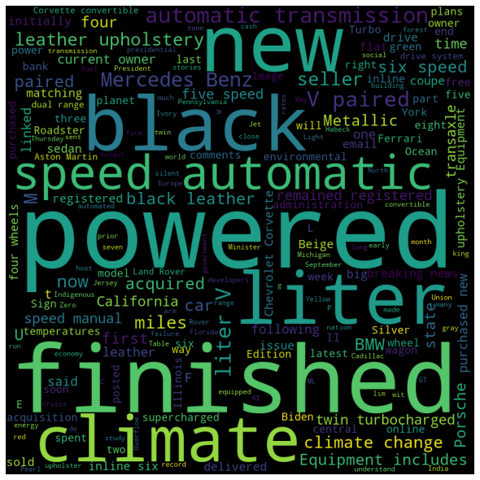
Topic Prediction Results
Models mis-classified topics and sentiment
Climate label was primarily being misapplied by editors the most
Average accuracy across all models was below 50%
Unigram features are poor predictors for topics and sentiment
Sentiment is dependent on context and combinations of words (ngrams)
Topics are discussed interchangeably (e.g. climate and weather or business and technology)
Climate and weather are similar topics and discussed interchangeably
Models generally significantly leaned towards the opposite sentiment (many neutral words across both positive and negative articles)
Notes:
Surprising top words for climate
Mental was the most common word for health, closely followed by world
Accuracy of sentiment predictions low
One man’s positive is another’s negative
Unigram features are poor predictors of sentiment due to "double negatives" and overall lack of context

Slide 8
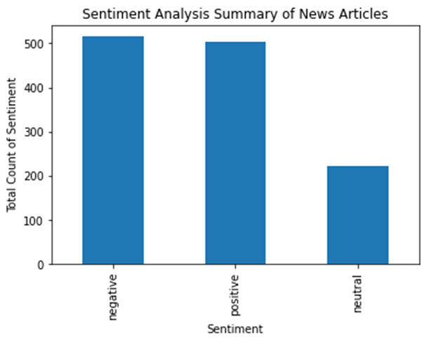
Sentiment Analysis
Equal # of positive and negative sentiment across all topics
Notes:
Will talk here about significance of words in the wordclouds

Slide 9
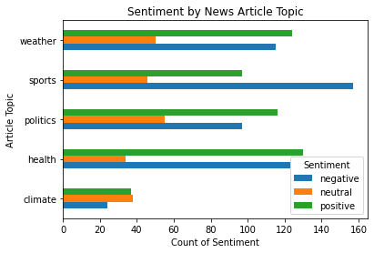
Sentiment Analysis
Sports had the highest negative to positive sentiment
Climate is the only topic with nearly equal positive to neutral sentiment
Health has a nearly equal ratio of positive and negative sentiment.
Weather and politics have a slightly higher positive to negative sentiment
Sentiment for Topic will Vary Based on Current Events and Issues
Notes:
Will talk here about significance of words in the wordclouds

Slide 10
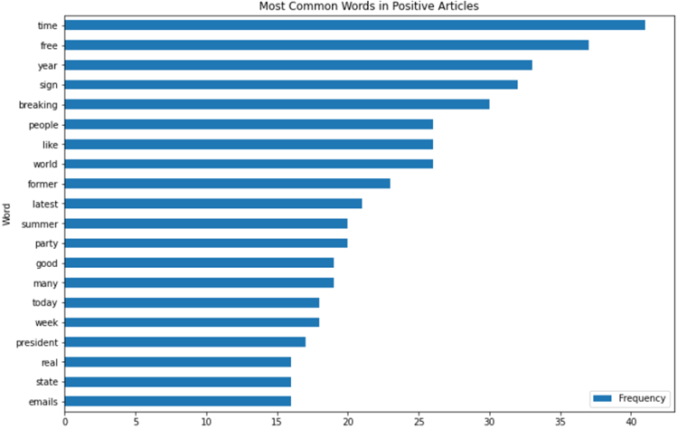
Sentiment Analysis
Examples of expected positive words: like, good, etc
Neutral words that will highly influence the model’s sentiment predictions: time, free, year, sign, breaking, etc.
Sentiment for Topic will Vary Based on Current Events and Issues
Notes:
Will talk here about significance of words in the wordclouds

Slide 11
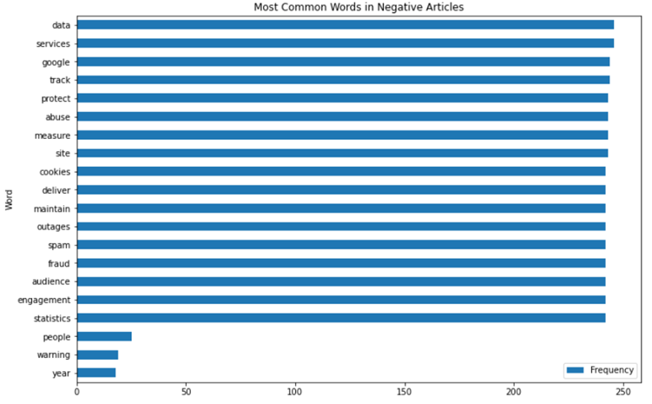
Sentiment Analysis
Expected negative words: abuse, outages, spam, fraud, etc.
Neutral words that will highly influence the model’s sentiment predictions: time, free, year, sign, breaking, etc.
Sentiment for Topic will Vary Based on Current Events and Issues
Notes:
Will talk here about significance of words in the wordclouds

Slide 12
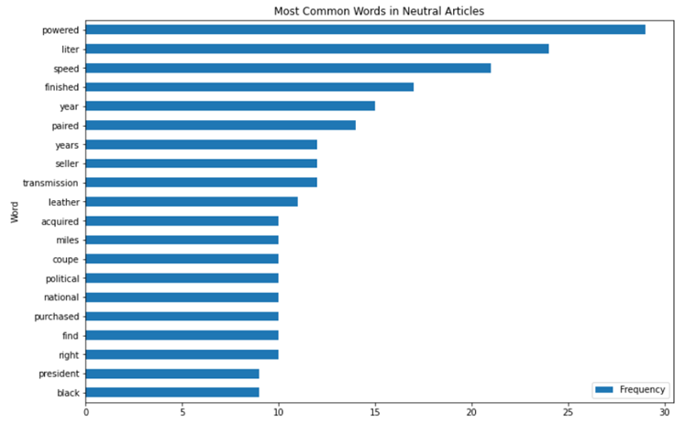
Sentiment Analysis
All neutral words are as expected and could contribute to positive or negative sentiment depending on context
Sentiment for Topic will Vary Based on Current Events and Issues
Notes:
Will talk here about significance of words in the wordclouds

Slide 13
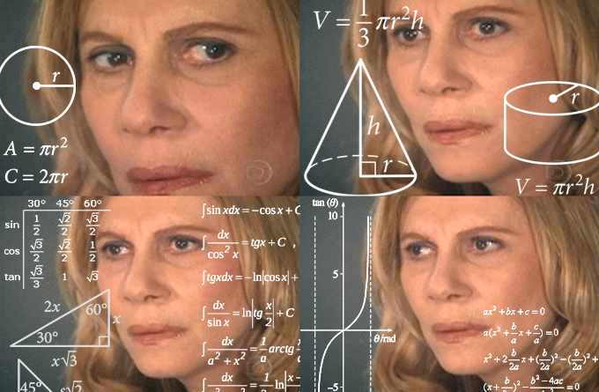



Conclusion
Difficult to predict topic or sentiment on individual words
Context matters depending current issues and events
Be aware of one’s sentiment biases on events or issues
Read from multiple sources to understand topic
Notes:
It is difficult to predict Topic or Sentiment based on a single word
Readers should take care to consider the many effects a particular event can have
A reader of an article that requires policy change should consider the impact such policy can have on society and the environment
Publishers can very easily misapply topic labels
If subscribing to ‘climate’, be wary of articles tangentially related that are designed to drive site traffic
Readers should be aware of own biases before deciding whether a news article is positive or negative
Two readers reading the same article can come to wildly different interpretations
Knowing internal bias can help prevent ignoring important news
The best way to understand an event is to read about it from multiple sources
Computers have a hard time replicating an inherent trait of humans, the ability to consider external data and arrive at a unique conclusion

Slide 14



Reflection
Employ additional text mining techniques and analyses to improve model prediction accuracy (e.g. n-grams and other sentiment analytic tools)
Data wrangling must be done in multiple stages
Text mining is resource intensive
(continue to refine data set with additional cleaning processes)
(should invest in high-performance local hardware or consider running analysis on cloud services)
Notes:
Text Mining is resource intensive
Should invest in high-performance local hardware or consider running analysis on cloud services
It would have likely been more useful looking at different n-grams rather than different vectorizers and algorithms
Data wrangling must be done in multiple stages
Start cleaning when data is in its most basic form with different applications, i.e. Excel, word, etc..
Refine data when able, either by cleaning more thoroughly or adding more data
Aids in development of robust pipelines and models

Slide 15

Signing Off...
Thank You!

